Slide 1

Team name: Solutioneers
Team leader name: Malaika Khattak
Problem Statement: In low-resource settings, early detection of pneumonia is often delayed due to lack of diagnostic tools and continuous monitoring. This results in preventable complications, hospitalizations, and higher mortality rates.

Slide 2

Solution And How It Work:
Collect Vital Signs:
Healthcare workers manually input basic vital signs — temperature, heart rate, oxygen saturation (SpO₂), and respiratory rate — using affordable devices.
Analyze Data with Machine Learning:
The system processes these inputs through a trained ML model (e.g., Random Forest) to predict pneumonia risk levels: Low, Moderate, or High.
Display Real-Time Results:
The risk assessment is instantly shown on an easy-to-use web app interface accessible on any device with a browser.
Support Clinical Decisions:
Health workers use this risk information to decide who needs urgent care or monitoring, enabling faster and more effective intervention.
Proposed Solution – HealthBridge AI
HealthBridge AI is an intelligent remote patient monitoring system designed to predict respiratory imbalance using machine learning.
It analyzes critical patient vitals including heart rate, respiratory rate, blood pressure, oxygen saturation, temperature, and pH.
Utilizes a Random Forest classifier for accurate and reliable risk prediction (Mild, Chronic, Severe).
Incorporates SHAP-based model explainability to provide transparent and interpretable results for healthcare professionals.
Delivered through a lightweight, user-friendly Streamlit web application for real-time risk assessment.
Tailored for use in remote and resource-constrained healthcare settings, supporting timely interventions and improved patient outcomes

Slide 3
How HealthBridge AI is Different
Uses basic vital signs easily measured with low-cost tools—no expensive equipment needed.
Works with manual input, so no continuous sensors or complex devices required.
Provides AI-powered risk predictions (Low, Medium, High) for quick decision-making.
Accessible via a simple web app—runs on any device with a browser, no installation needed.
Specifically designed for low-resource, remote settings where advanced medical tools aren’t available.
Unique Selling Proposition (USP)HealthBridge AI uniquely combines affordable vital sign monitoring with AI-driven pneumonia risk prediction in a simple, browser-based tool — enabling early detection and timely care in low-resource and remote healthcare settings without the need for expensive equipment or specialized training.

Slide 4
Key Features of HealthBridge AI
Basic Vital Sign Input
Manual entry of temperature, heart rate, oxygen saturation (SpO₂), and respiratory rate using affordable devices.
AI-Powered Pneumonia Risk Prediction
Machine learning model classifies patients into Low, Moderate, or High risk for pneumonia based on vital signs.Real-Time Results DisplayInstant risk assessment shown on a clean, User-Friendly Web Application
No installation or technical skills required; designed for easy use by healthcare workers in low-resource settings.
Explainable AI (Optional)
Provides transparent insights into predictions through model interpretability techniques like SHAP.
Low-Cost and Scalable Solution
Designed for deployment in rural clinics, mobile health units, and community health programs.Offline Capable (Optional)Potential for local deployment without continuous internet connectivity to suit remote areas.

Slide 5
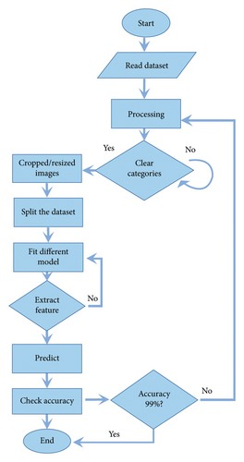
USE-CASE DIAGRAM:

Slide 6
Existing Apps:
Feature | Existing Systems | PneumoBridge AI
Hardware Required | Yes (Pulse oximeters, X-ray, etc.) | No (Manual input only)
Continuous Monitoring | Required | Not required (one-time input OK)
Works Offline | Rare | Possible with local deployment
Explainability | Usually No | Optional SHAP integration
Cost | High | Very Low (open-source + basic tools)
Target Users | Clinicians in hospitals | Frontline health workers, rural clinics

Slide 7
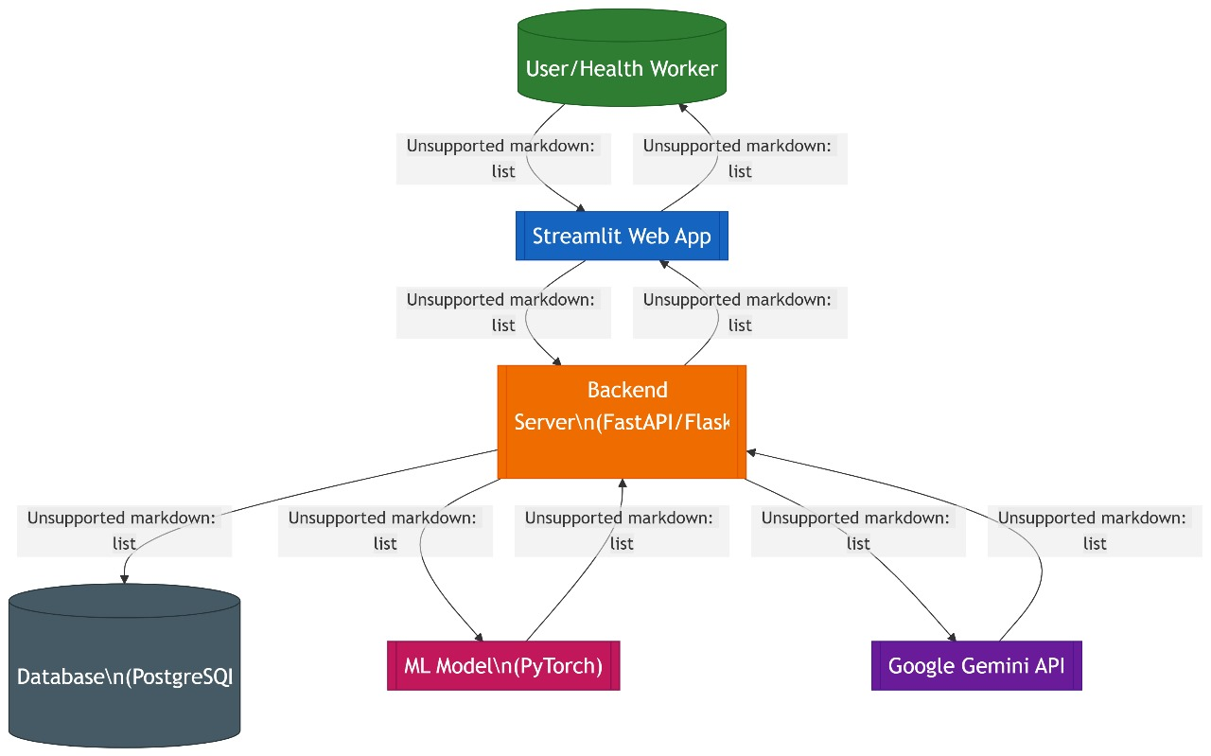
Architecture diagram of the proposed solution

Slide 8
Technologies Used:
Python :Programming language
Pandas / NumPy : Data preprocessing
Scikit-learn : ML model (Random Forest Classifier)
Streamlit : Web-based frontend interface
Google Gemini API : For generating explanations in natural language
SHAP (optional) : Model interpretability

Slide 9
Estimated software and hardware cost:
Item | Description | Cost Estimate
Developer Time (Team Project) | Student/fellowship contribution | $0 (Self-built)
GitHub Hosting (Open-source) | Free GitHub repo | $0
Streamlit Cloud (App Hosting) | Free tier available | $0
Google Gemini API (Limited usage) | Free under Maker Suite limits (100s of calls/mo) | $0
Item | Description | Estimated Cost (USD)
Digital Thermometer | Basic clinical thermometer | $5–$10
Finger Pulse Oximeter | Measures SpO₂ and heart rate | $10–$15
Manual Respiratory Rate Entry | Based on observation or stopwatch | $0
Smartphone/Tablet Access | Any basic Android phone/tablet | Existing or $50–$100

Slide 10
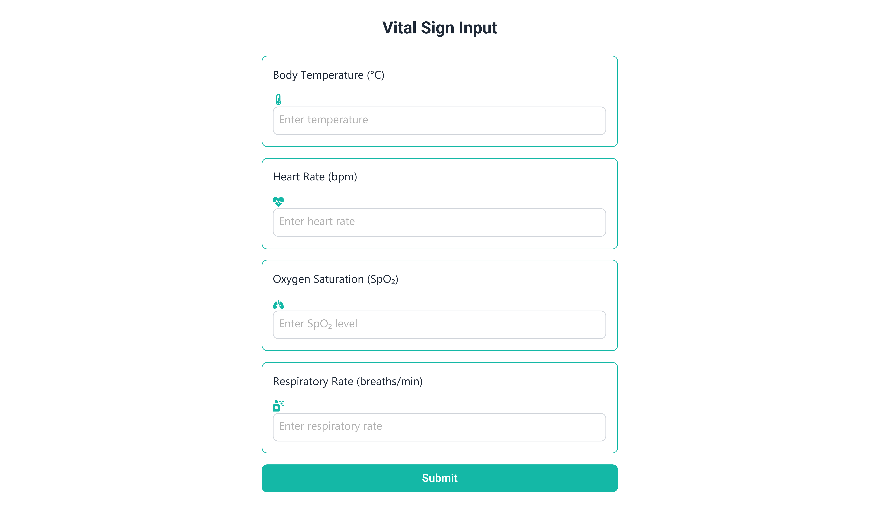
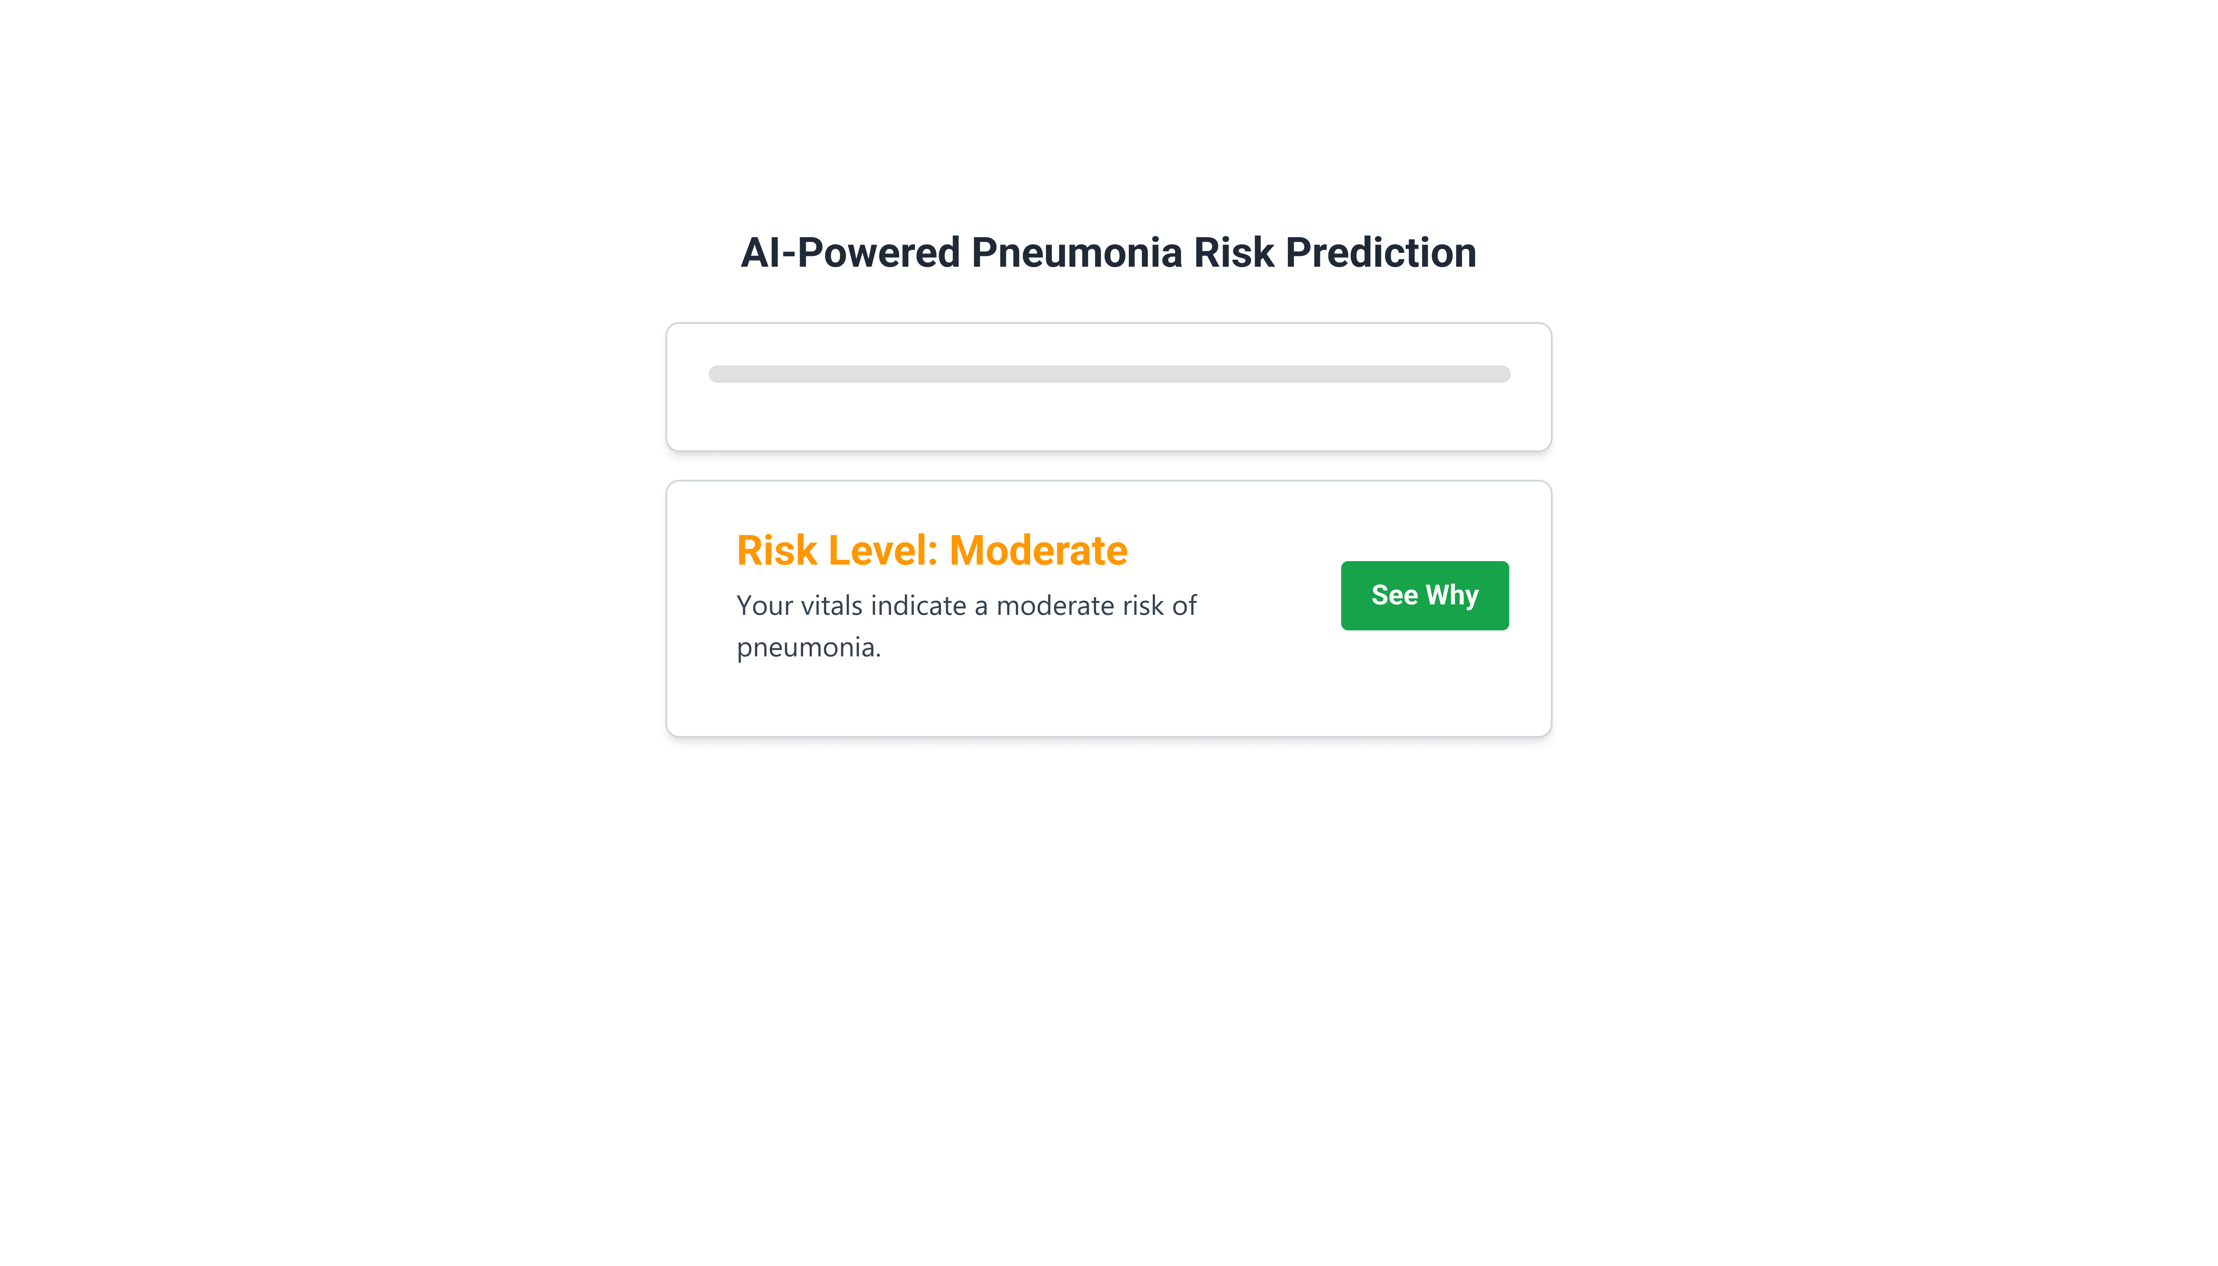
Snapshots of the prototype

Slide 11
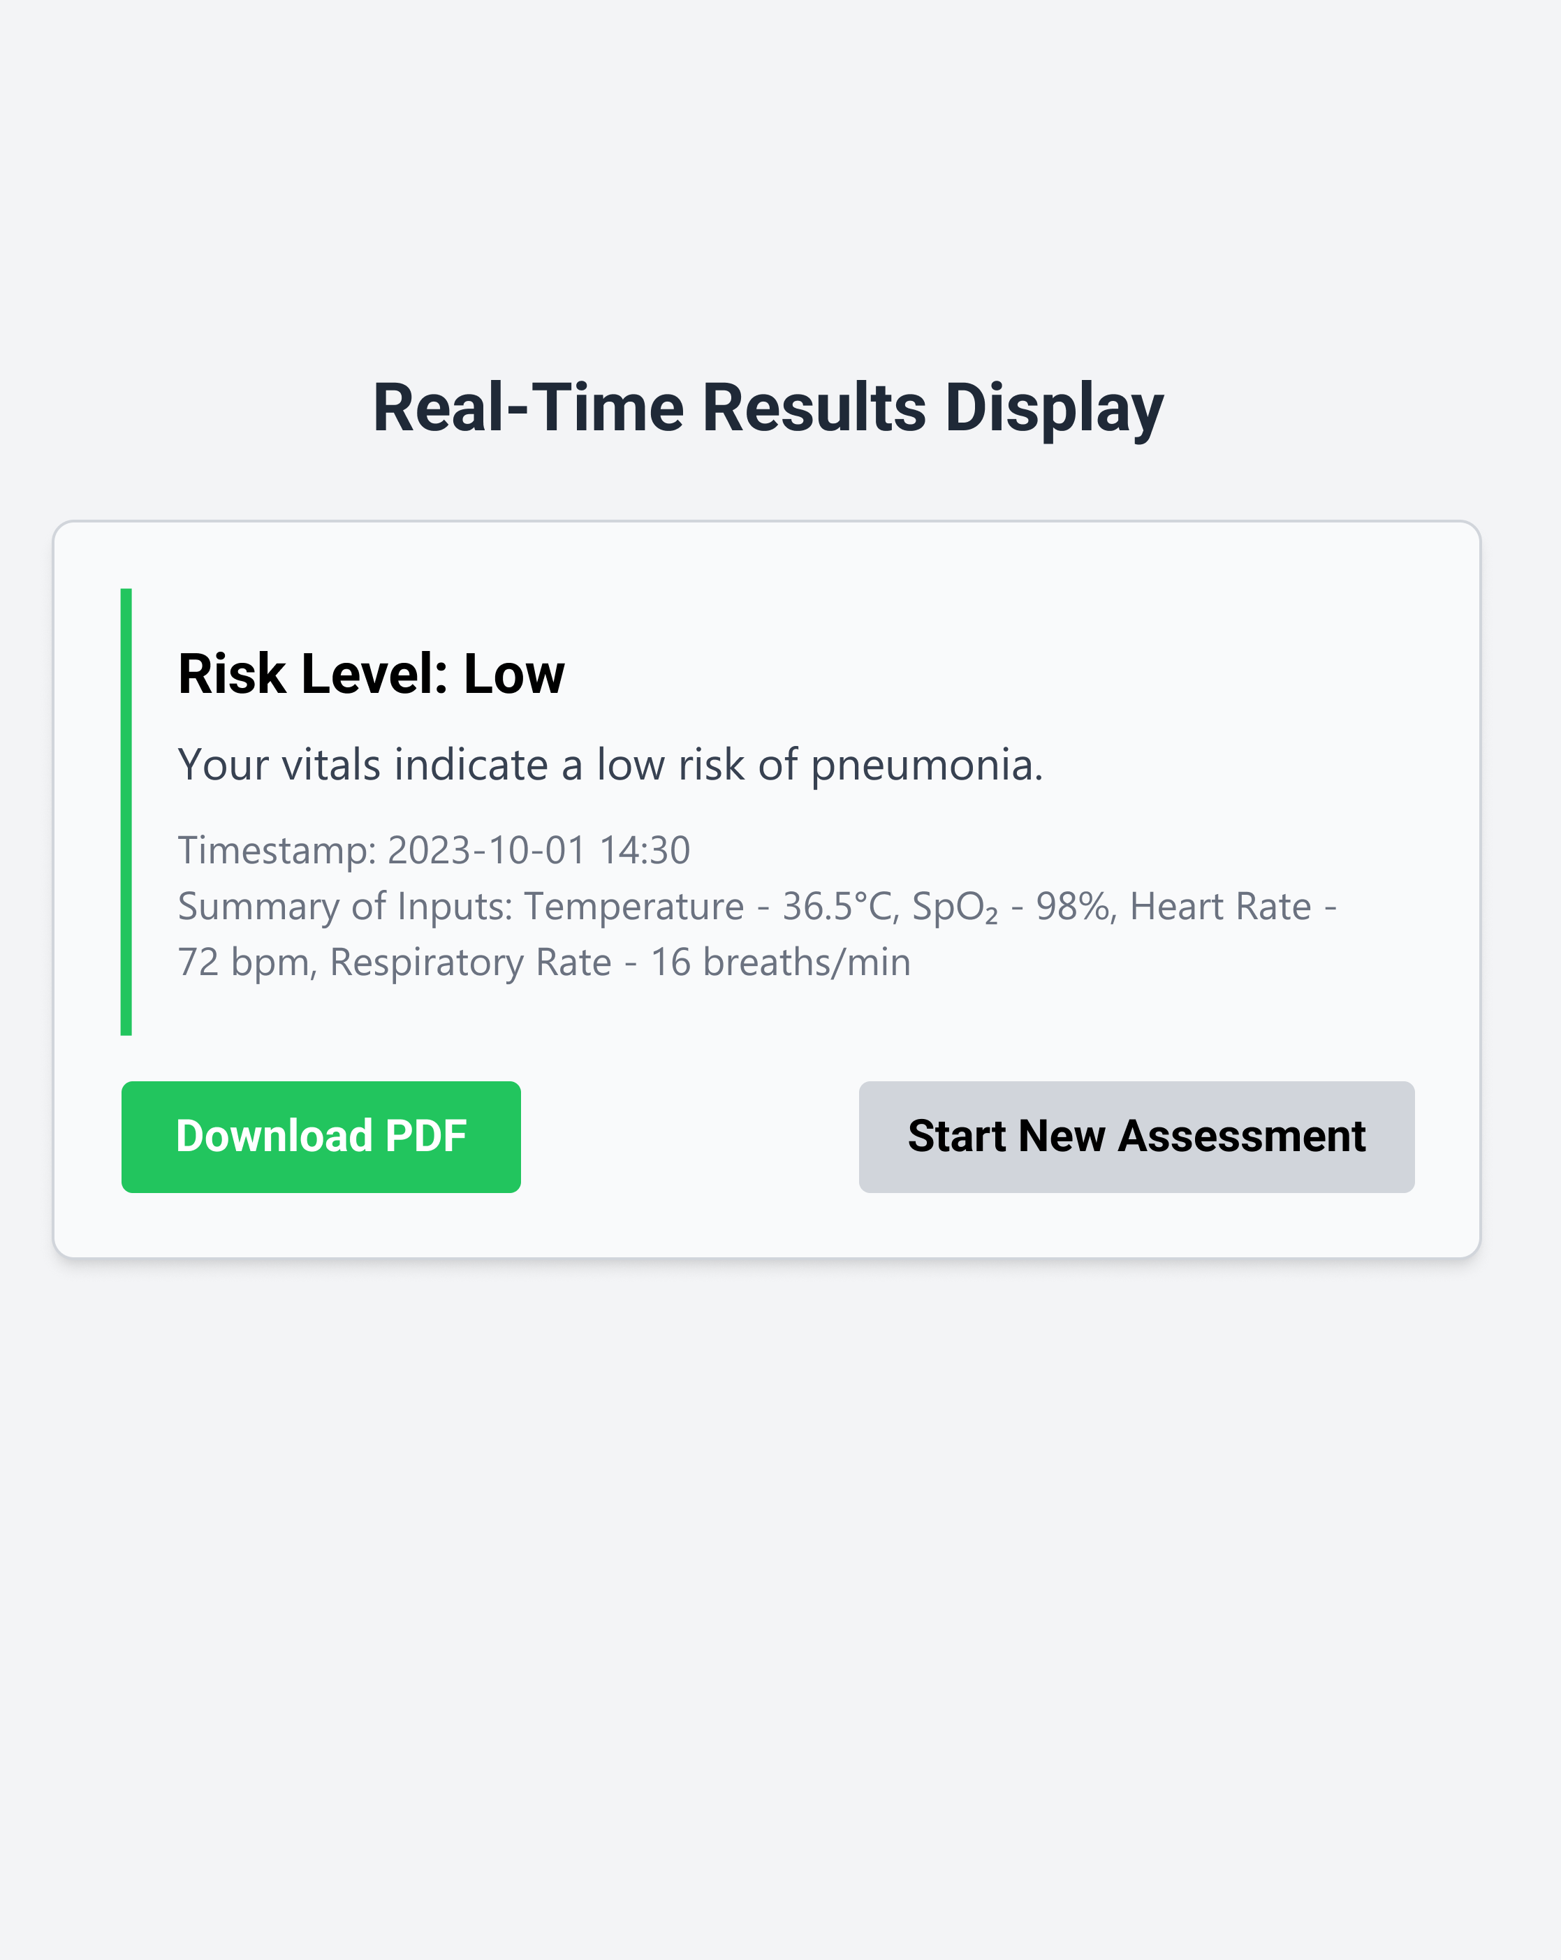
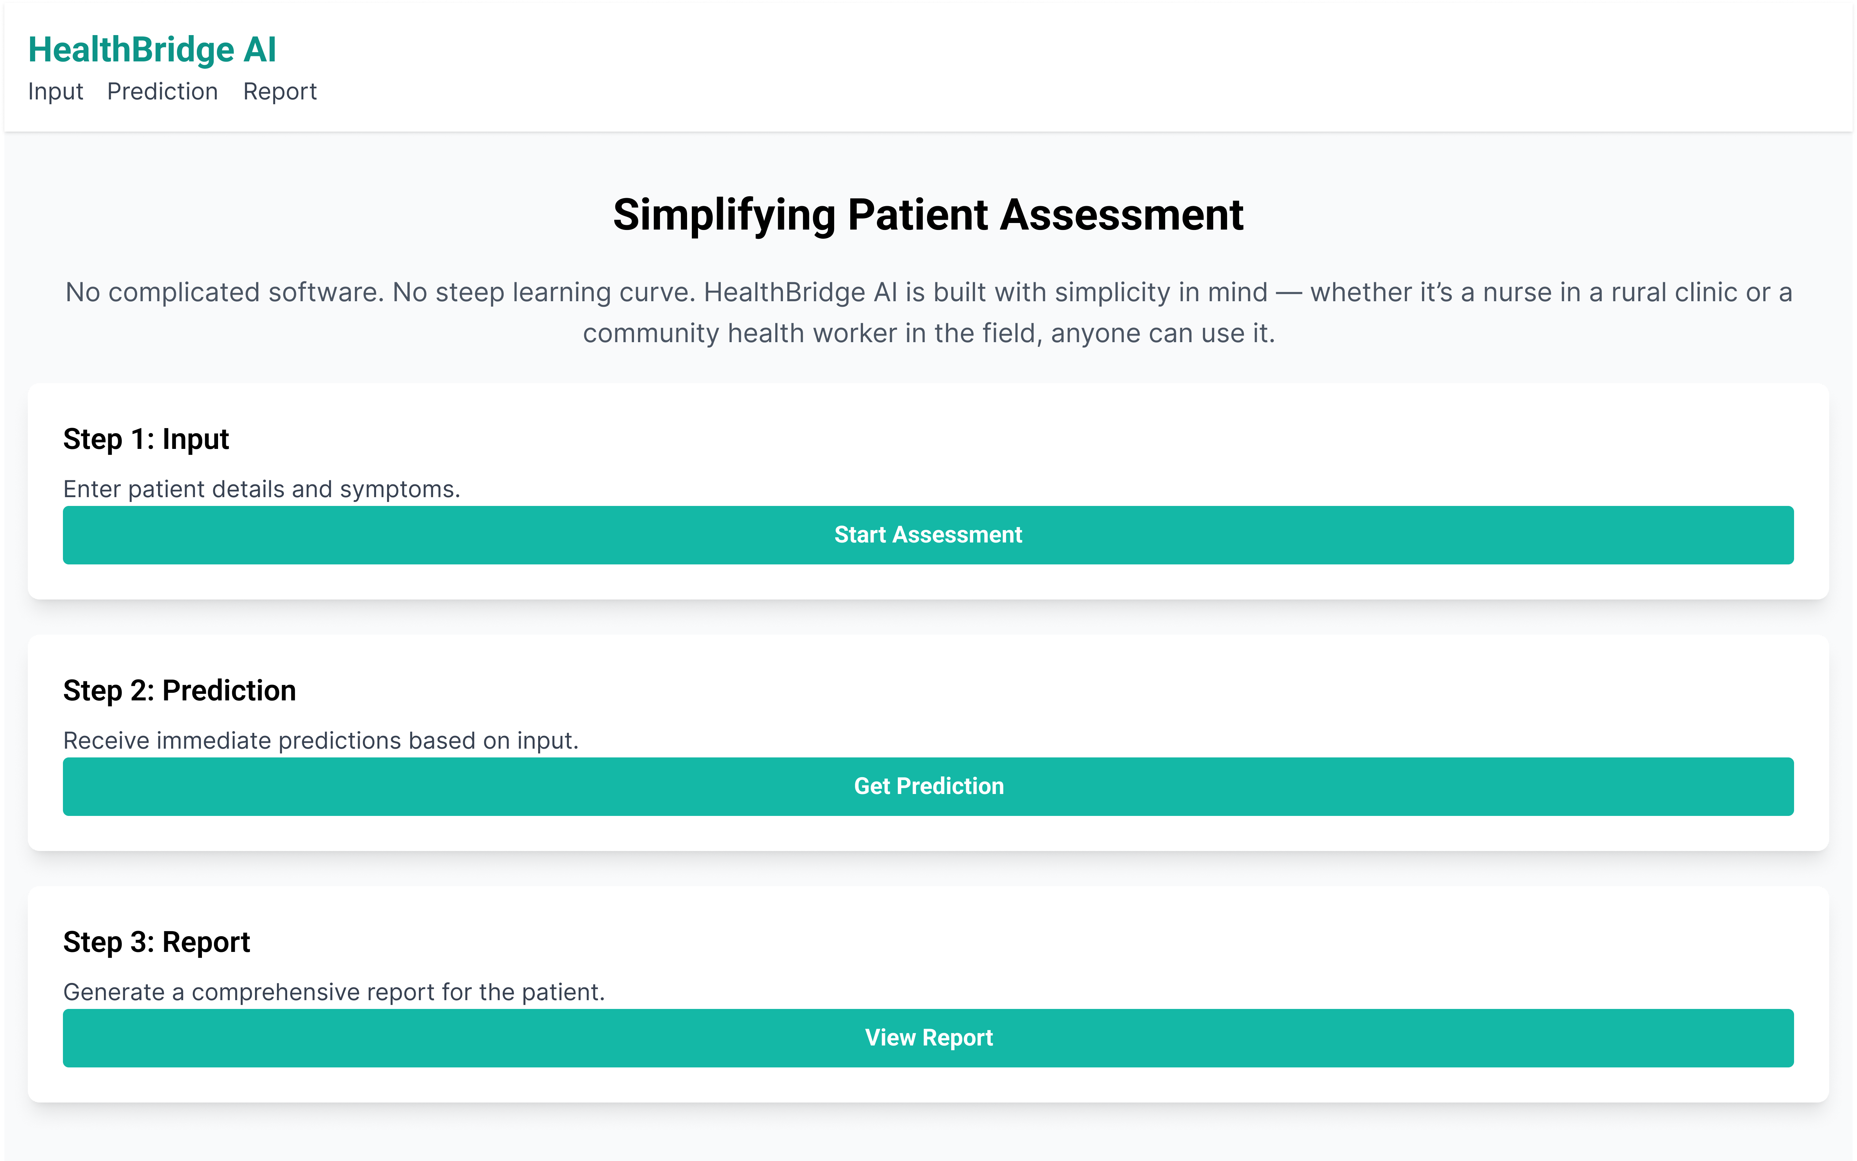
Additional Details/Future Develop

Slide 12
Provide links to your:
https://youtu.be/27iv0-1naPw?si=dBpOEJvNDYPAi3bf
https://solutioners-8q66upytrgrtmtvaptjp8z.streamlit.app/

Slide 13
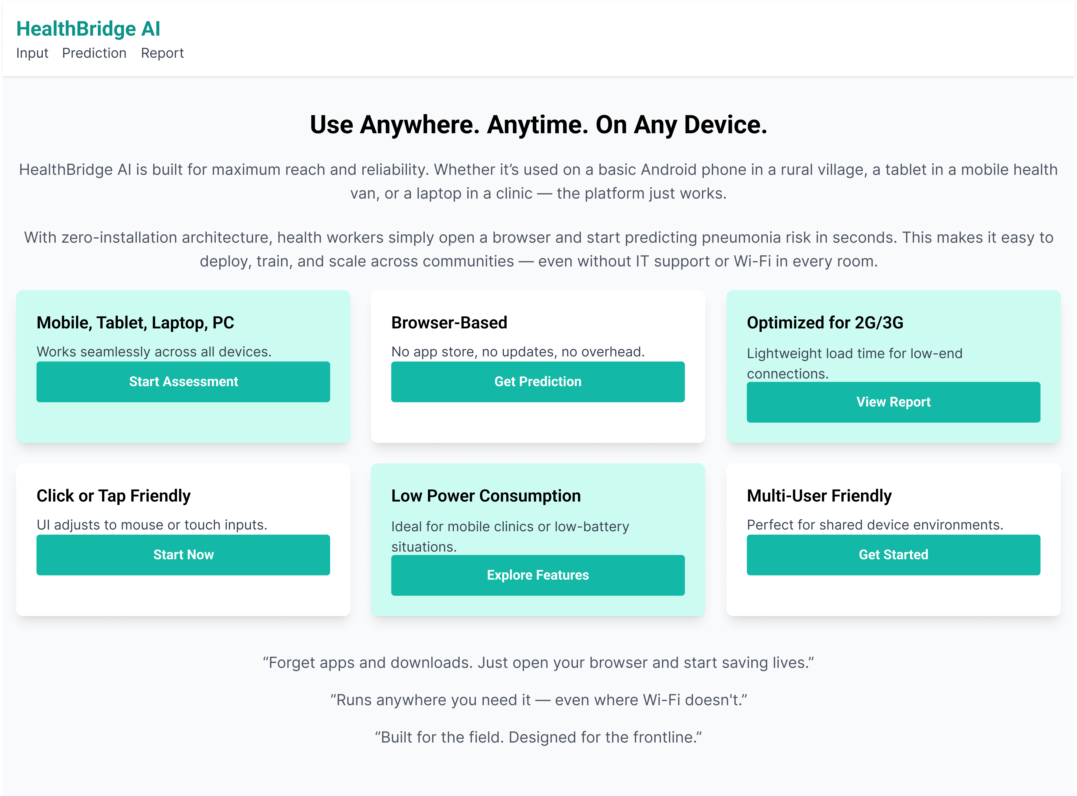

Slide 14
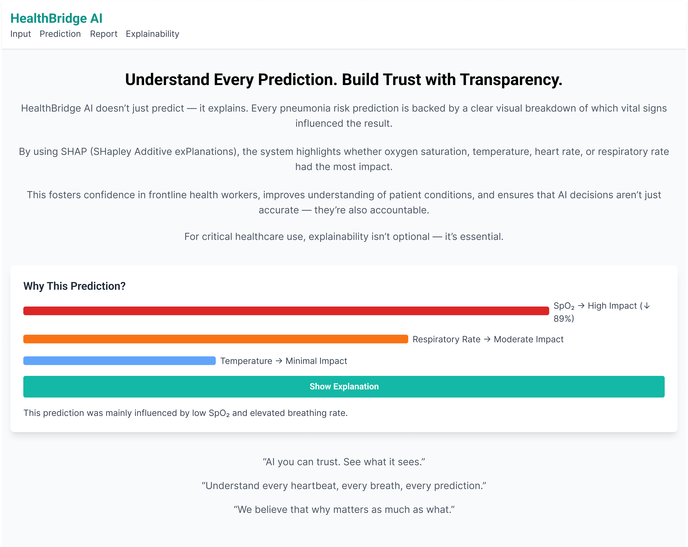

Slide 15
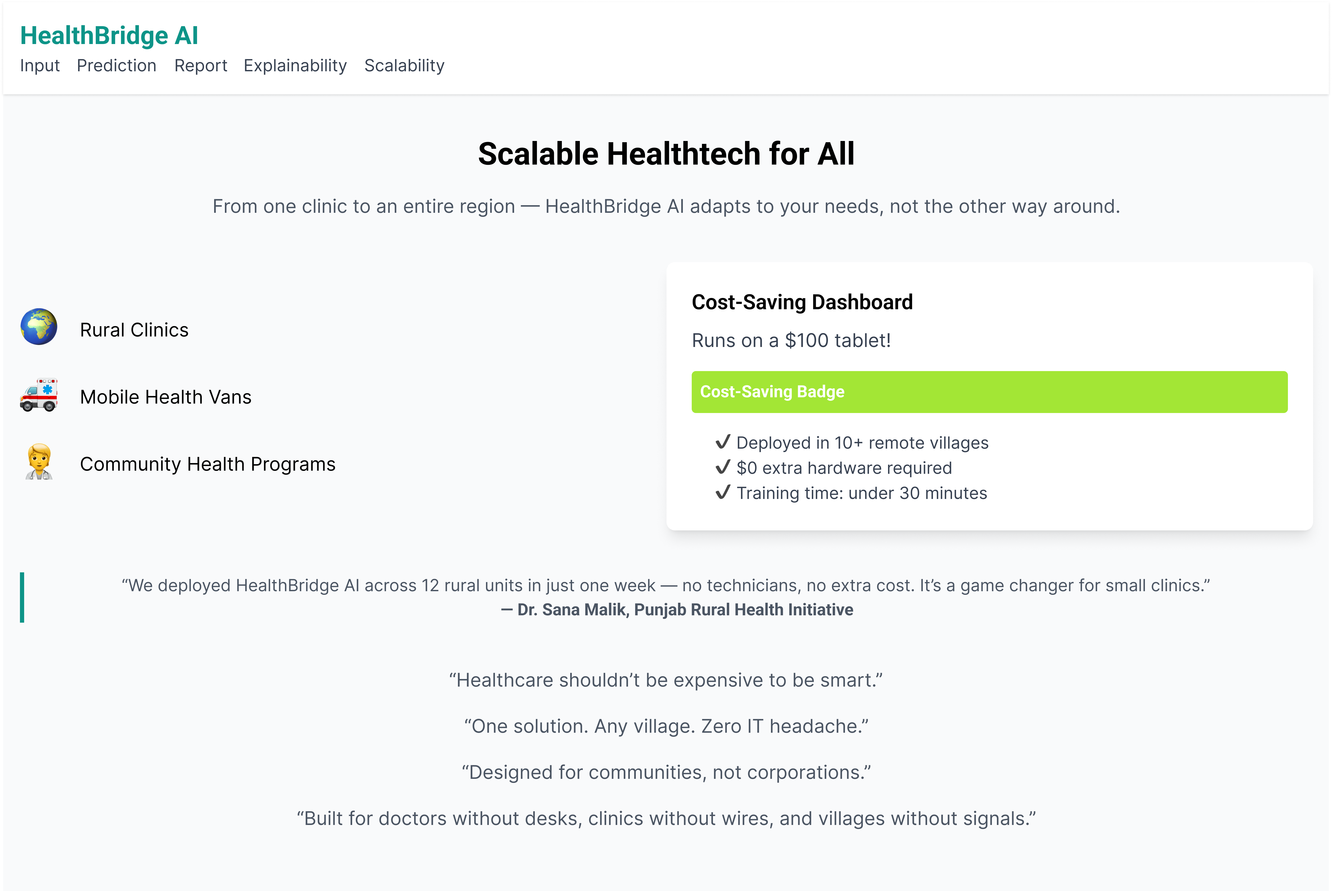
;

Slide 16


